Slide 1


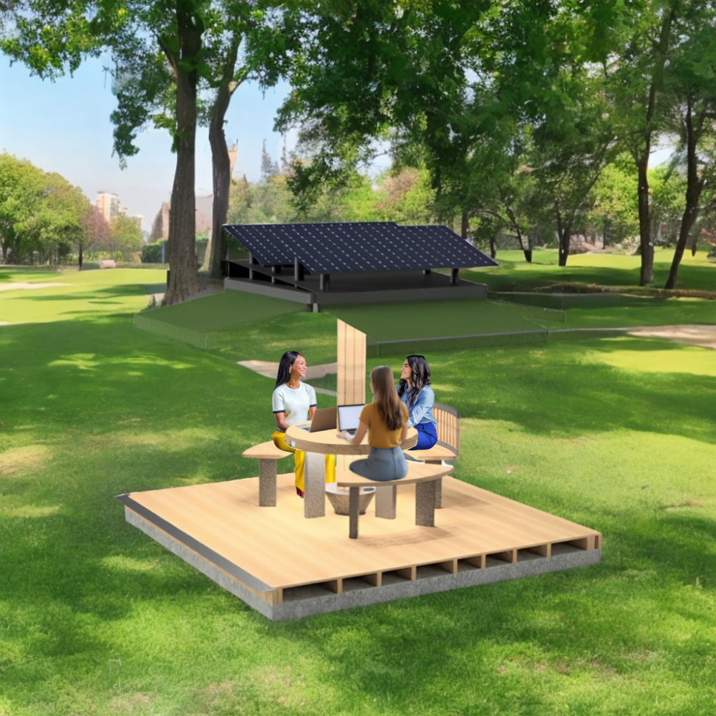







CO-VENIENT
CO-VENIENT
We Make It Better
We Make It Better
18th June 2025
Notes:
Tomás
Hello everyone. We are team coconut and we are going to present our product co-venient.

Slide 2



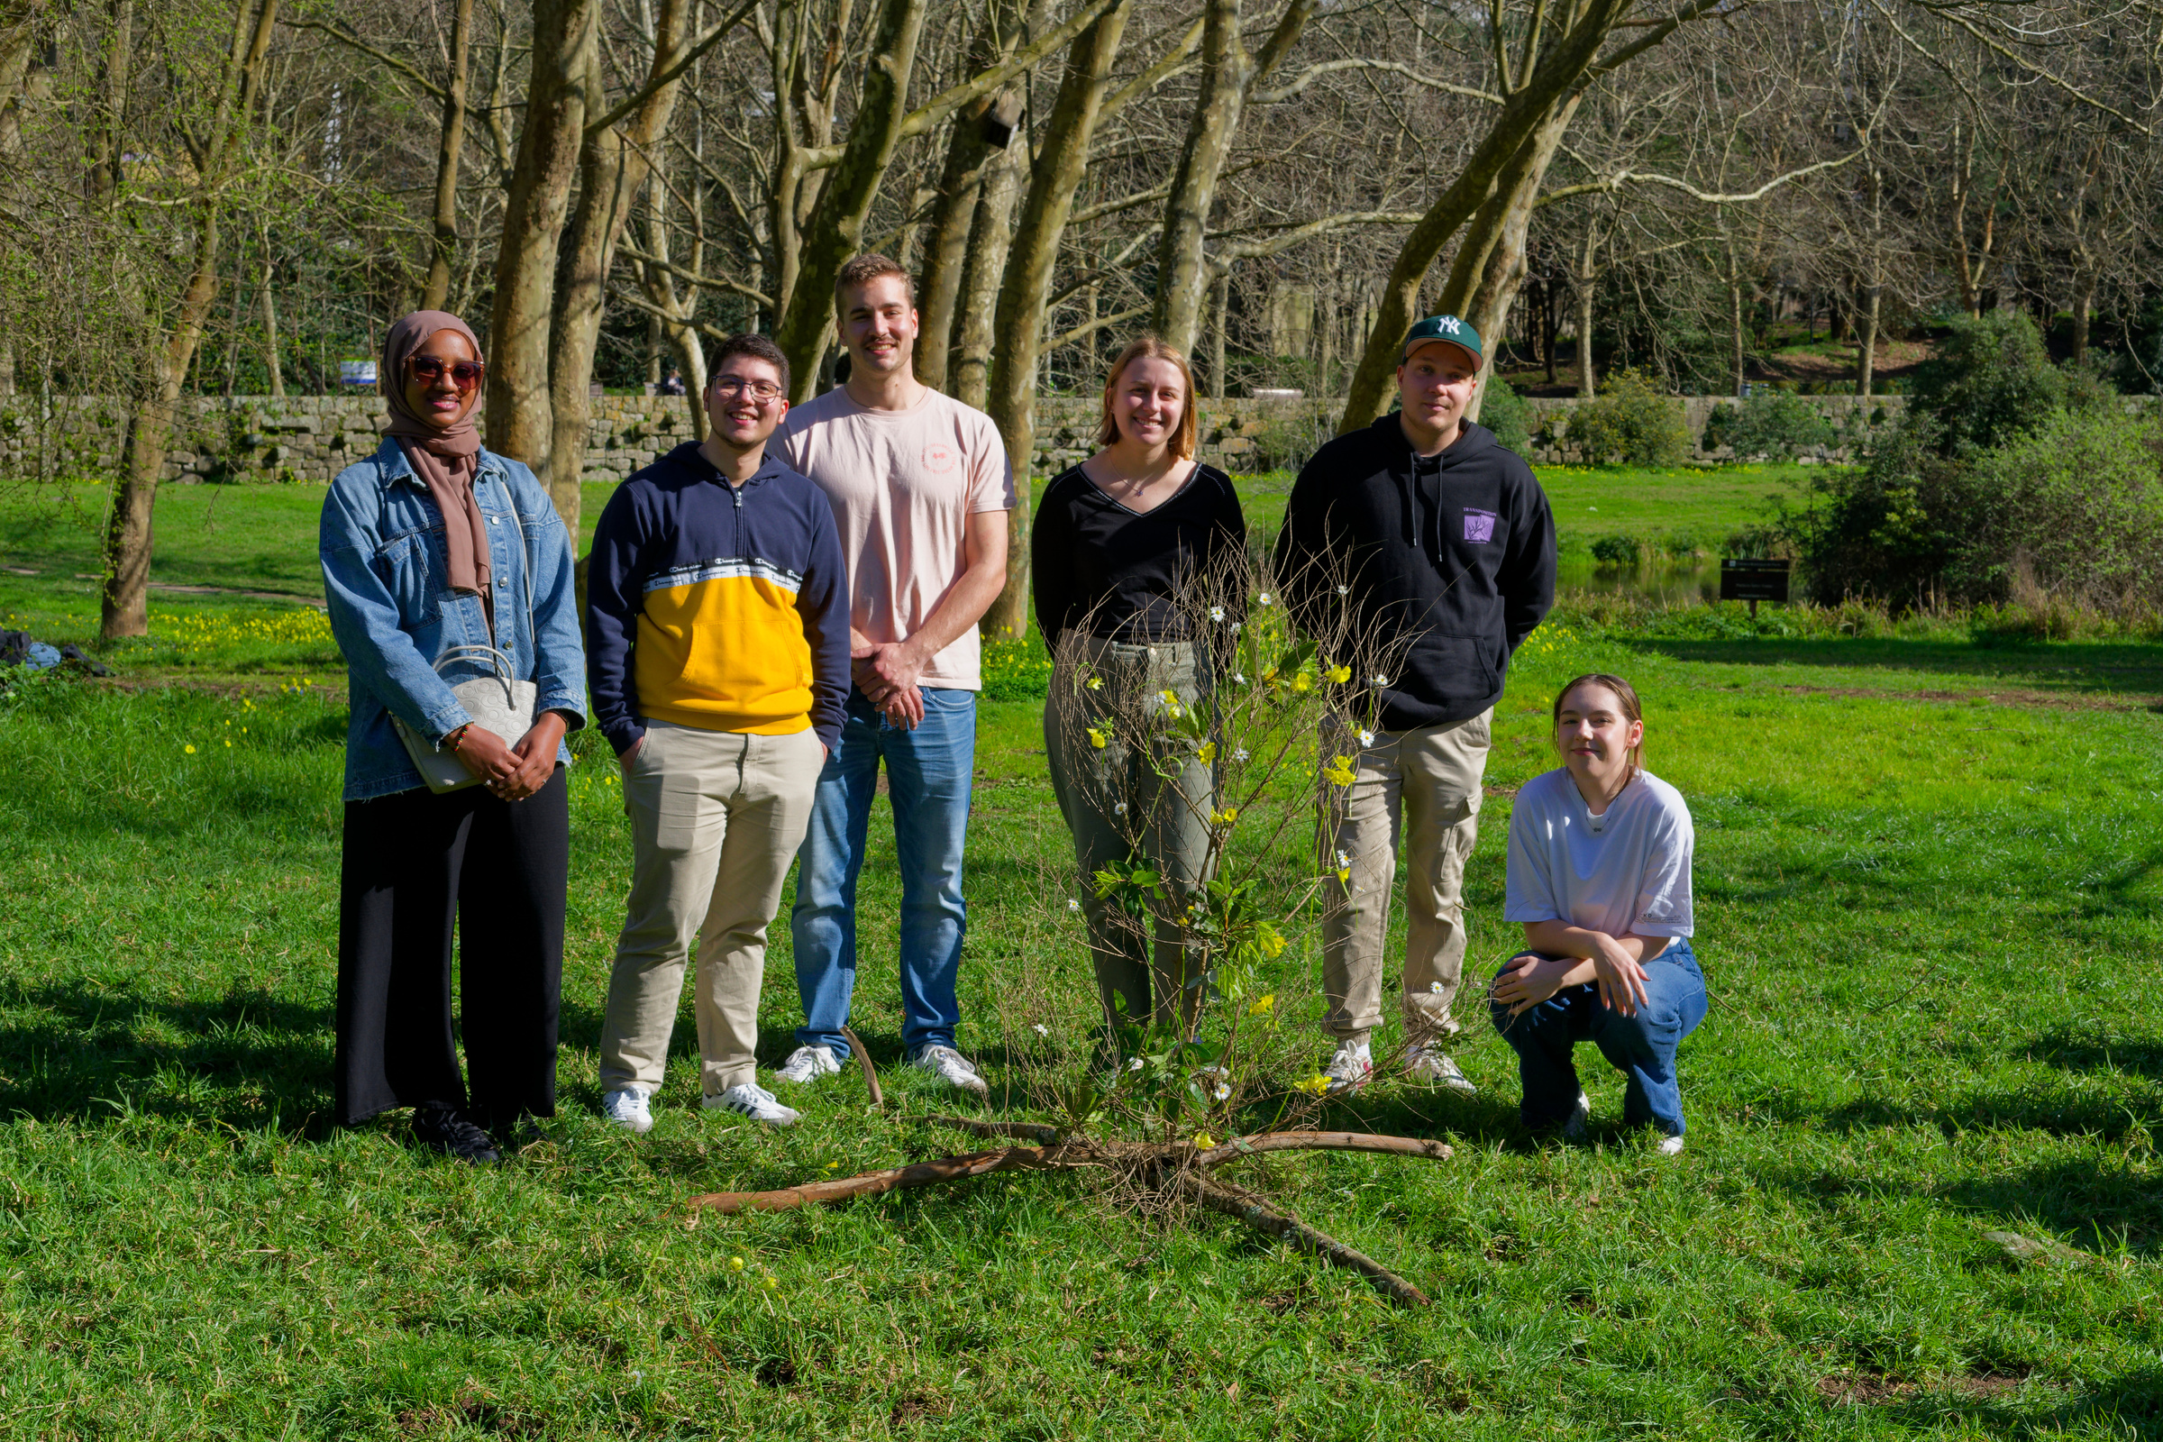
Pierre
Marion
Tomas
Aaro
Wiktoria
Waad
OUR TEAM
Notes:
Tomás
This is our team: Waad, Pierre, Marion, Aaro, Wiktoria and me, Tomás.

Slide 3


PROBLEM
1 MILLION PORTUGUESE
1 MILLION PORTUGUESE PEOPLE
Worked from home in 2023
Worked from home in 2023
Notes:
Aaro
-Put a question + text

Slide 4

3D MODEL
Notes:
Marion

Slide 5
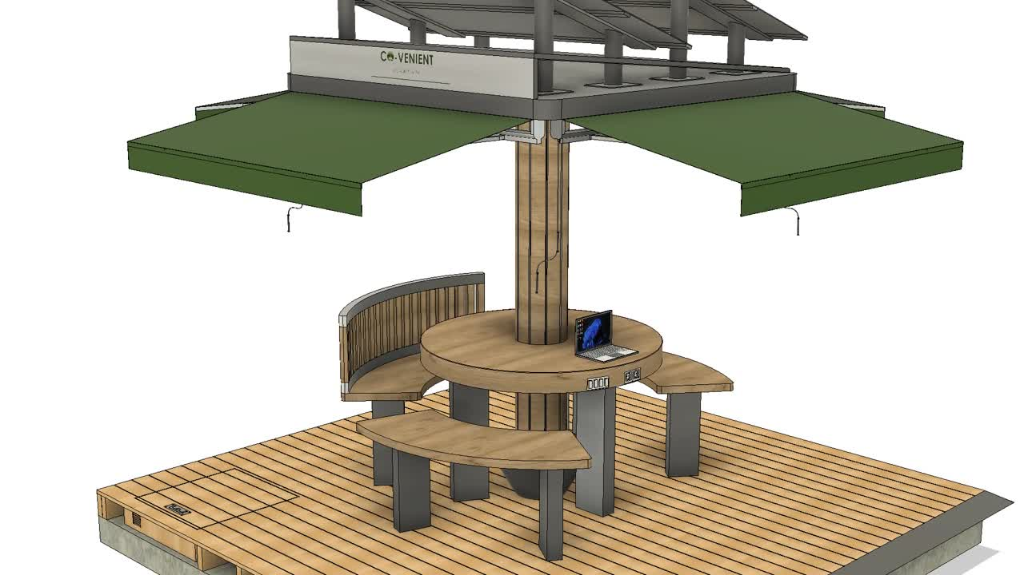
Notes:
Marion

Slide 6
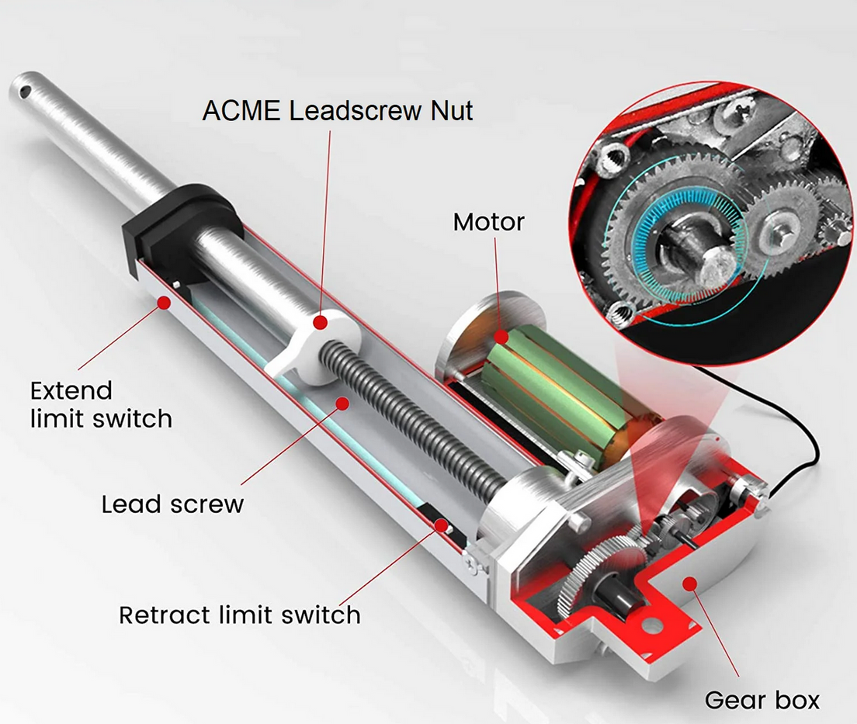
HOW
IT
WORKS
Notes:
Pierre

Slide 7
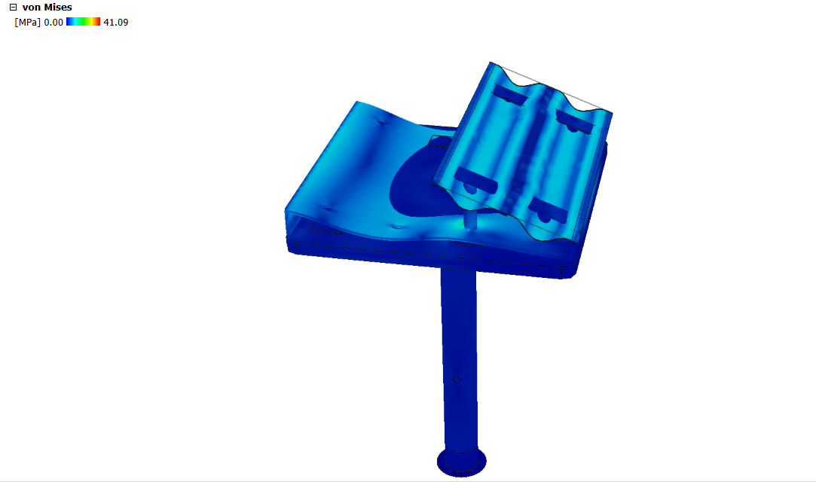
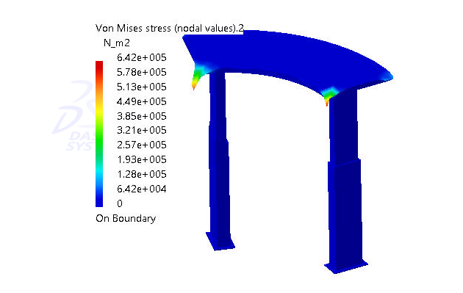
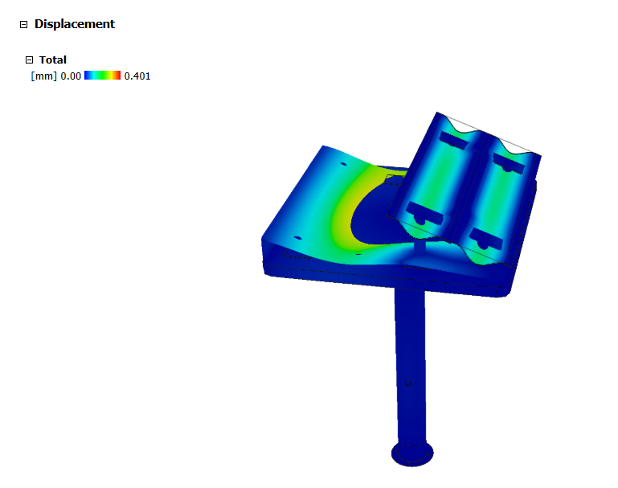
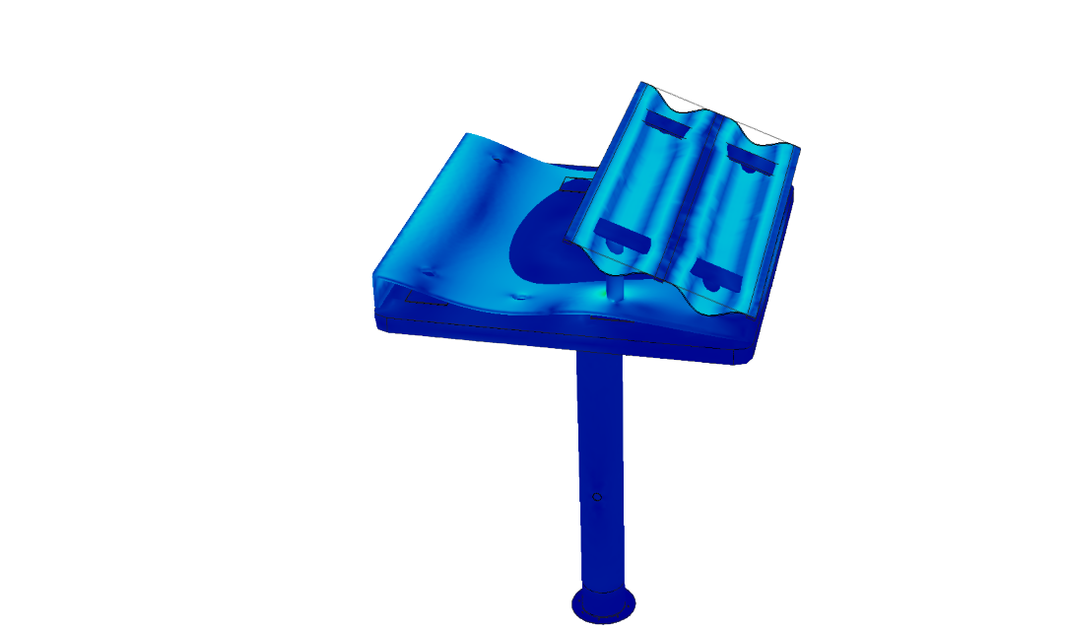
WE TESTED!
Notes:
Waad

Slide 8

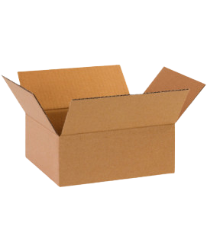
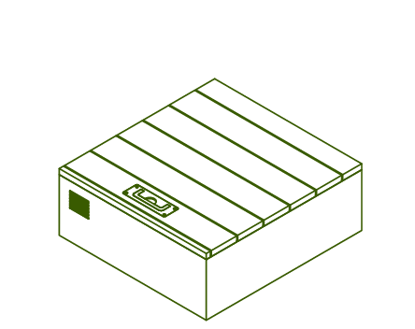
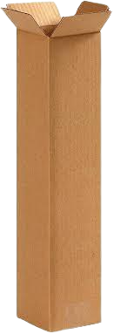
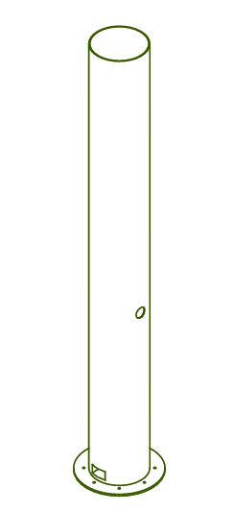

WOODEN PALLET
POLYWOOD CRATE
REUSABLE CRATES
  CARDBOARD BOXES
AND
PACKED
Notes:
Waad

Slide 9
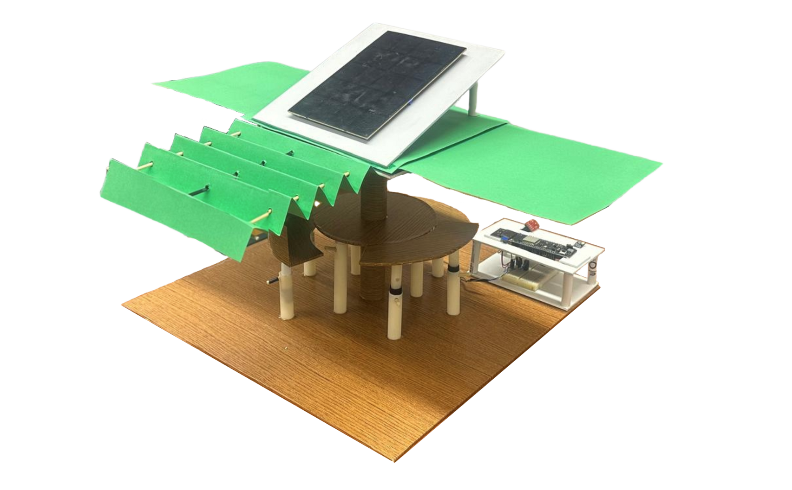

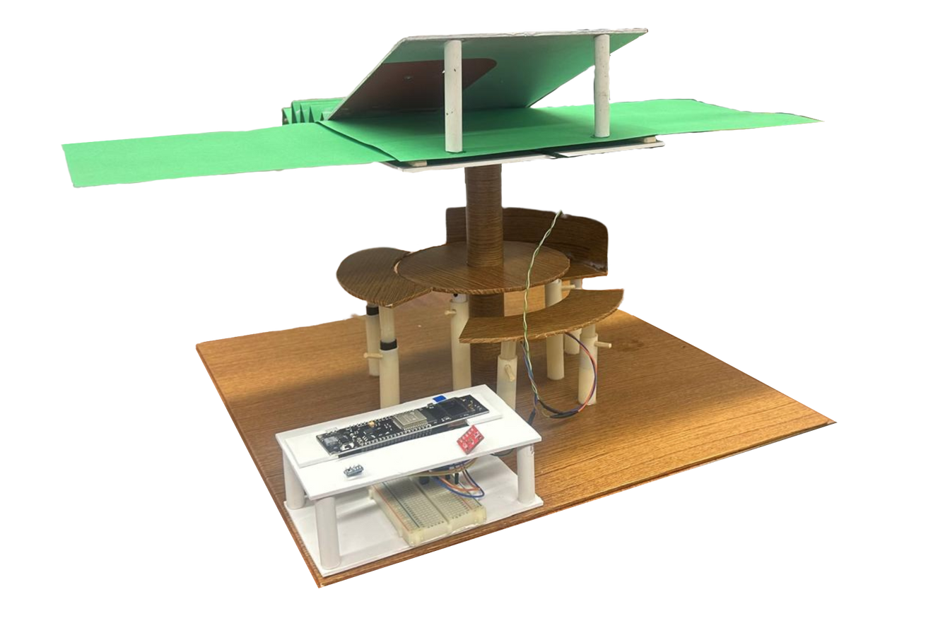
PROTOTYPE
Notes:
Tomás
- Talk while someone present the prototype

Slide 10



WE TESTED THIS
TOO!
AUTOMATIC LIGHTING
ADJUSTABLE WORK SURFACE HEIGHT
MANUALLY OPERATED AWNINGS
WI-FI COMMUNICATION
Notes:
Waad

Slide 11

CONSUMPTION
GENERATION
2655 WH
4280 WH
POWER DETAILS

Slide 12
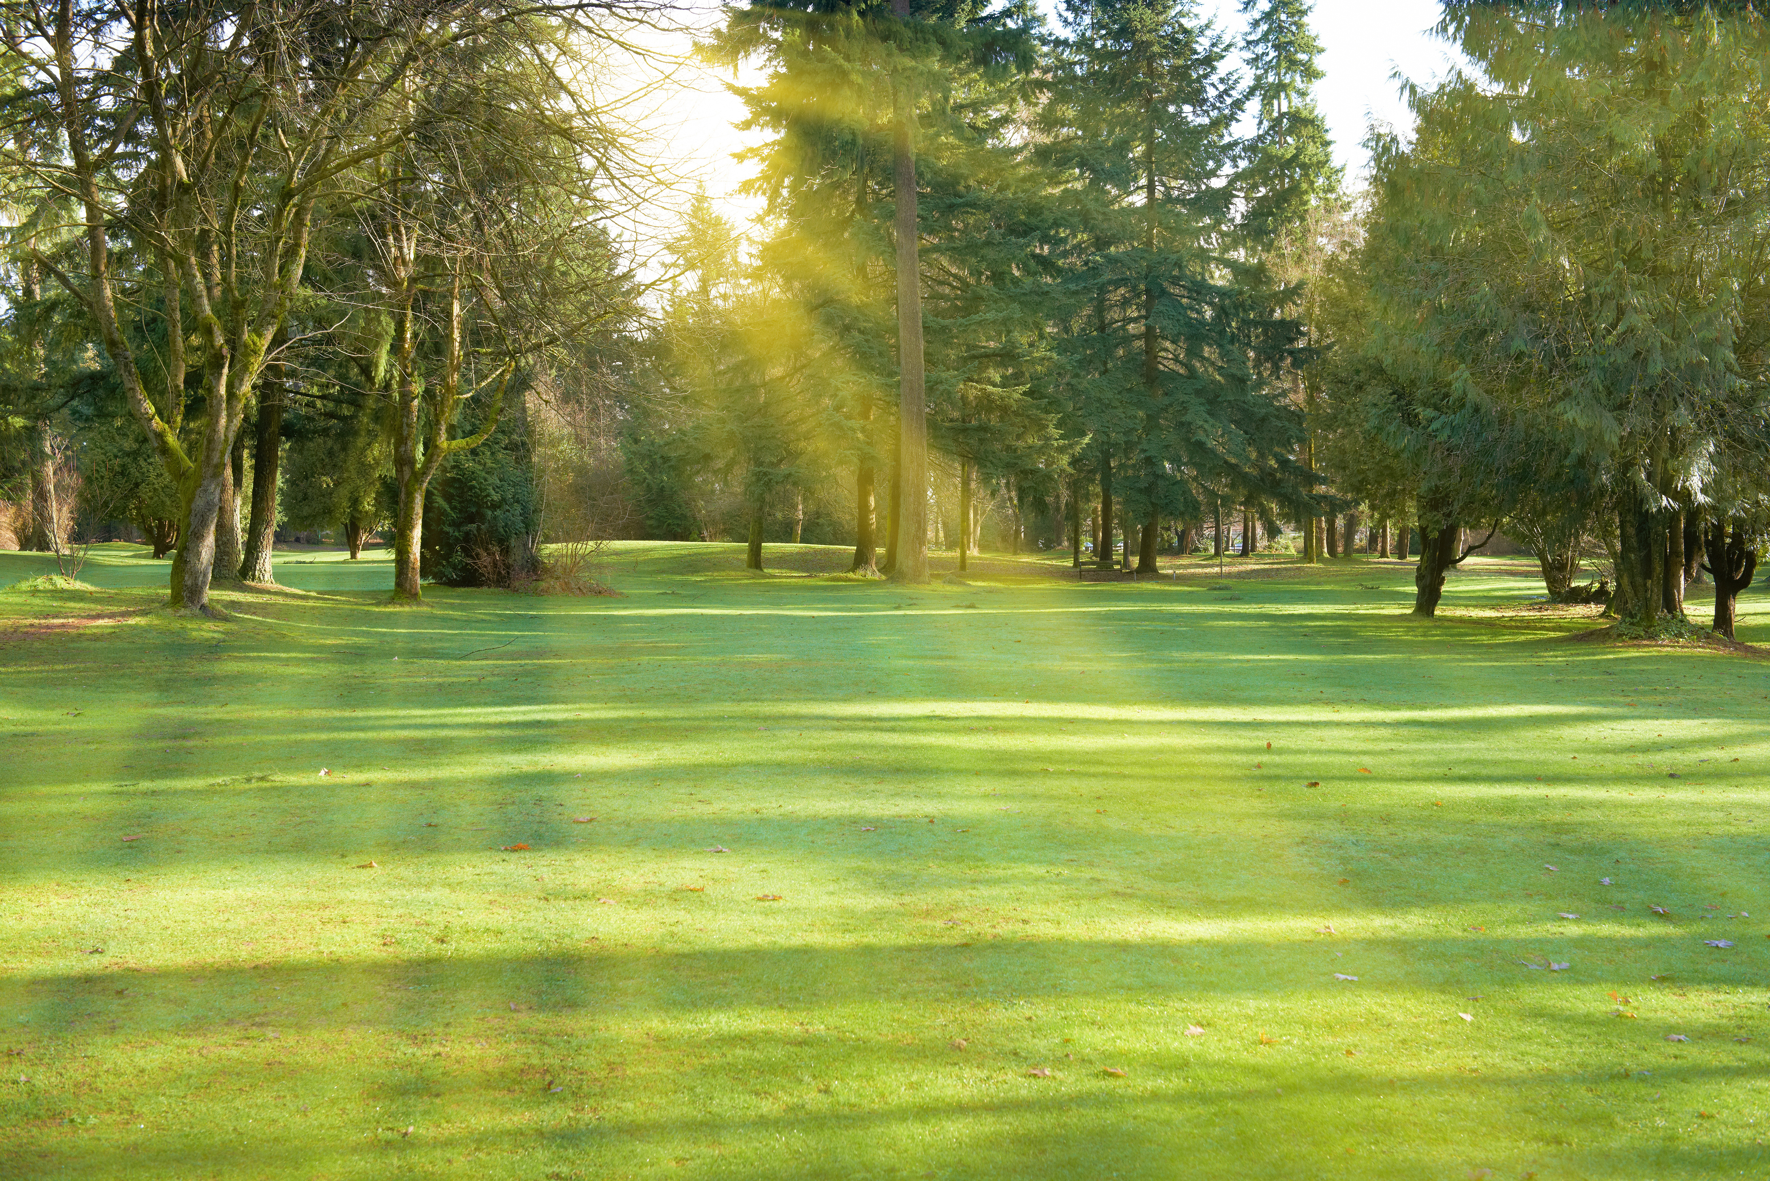



SAFETY
ACCESSIBILITY
COMFORT & USABILITY
WE CARE
ABOUT
ETHICS
SUSTAINABLE MATERIALS
SOLAR ENERGY
END-OF-LIFE RECYCLING
FREE WI-FI AND CHARGING
TRANSPARENT COMMUNICATION
INCLUSIVE OUTREACH
Notes:
Pierre
core ethical principles:
- safety
- accessibility
- comfort
environmental ethics:
- sustainable materials
- solar energy
- end-of-life recycling
social responsibility:
- free wi-fi and charging
- transparent communication
- inclusive outreach

Slide 13
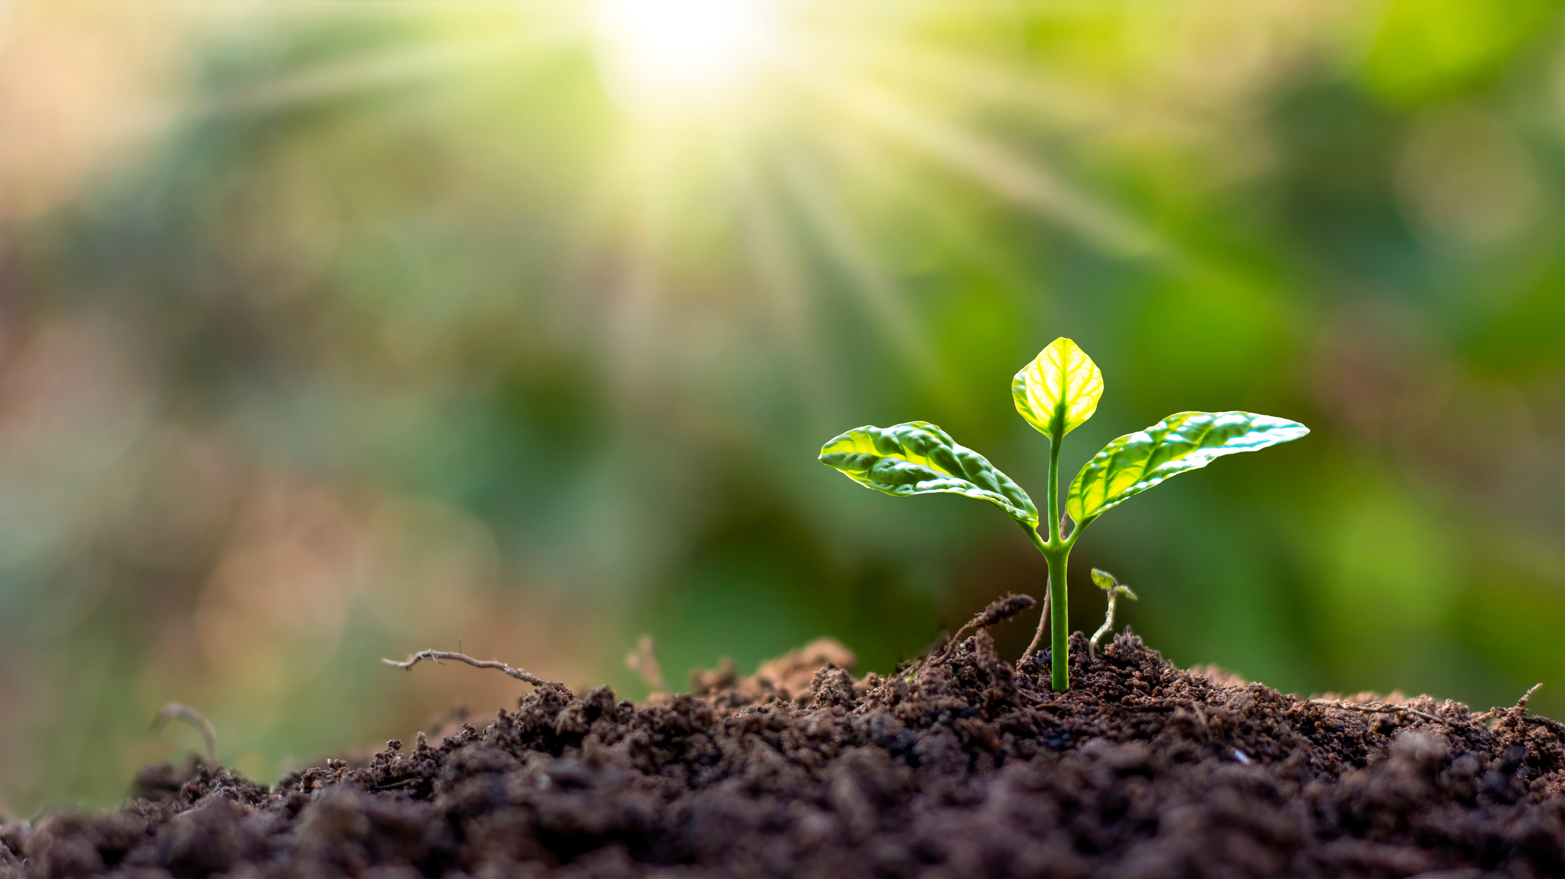





AND
ABOUT SUSTAIBABILITY
Notes:
Marion

Slide 14



WHO SHOULD BUY IT
MUNICIPALITIES
UNIVERSITIES
COMPANIES
Notes:
Aaro

Slide 15



KEY USERS
REMOTE WORKERS
STUDENTS
ENTREPRENEURS
Notes:
Aaro

Slide 16


HOW
WE
PROMOTE
SOCIAL MEDIA
PHYSICAL MATERIALS
Notes:
Pierre
core ethical principles:
- safety
- accessibility
- comfort
- usability
environmental ethics:
- sustainable materials
- solar energy
- end-of-life recycling
social responsibility:
- free wi-fi and charging
- transparent communication
- inclusive outreach

Slide 17


THROUGH
LEAFLETS
Notes:
Wiktoria

Slide 18
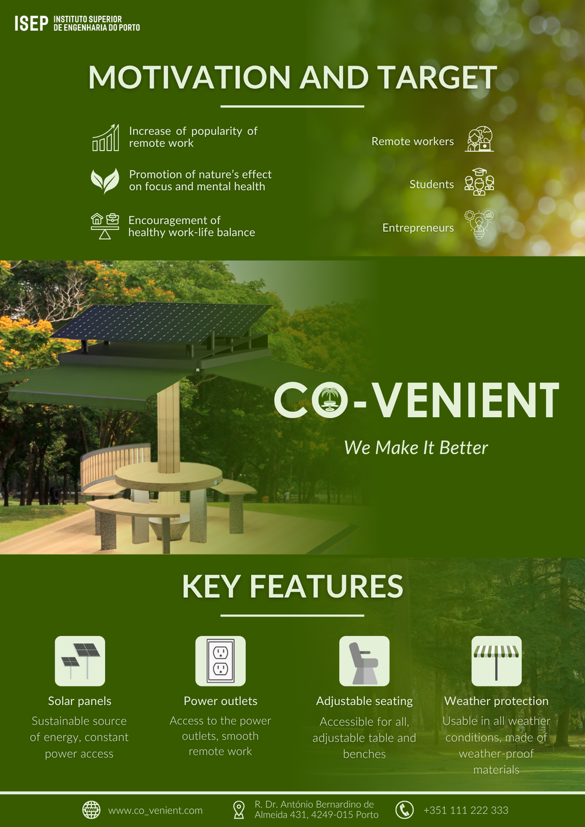
AND
POSTERS
Notes:
Waad

Slide 19
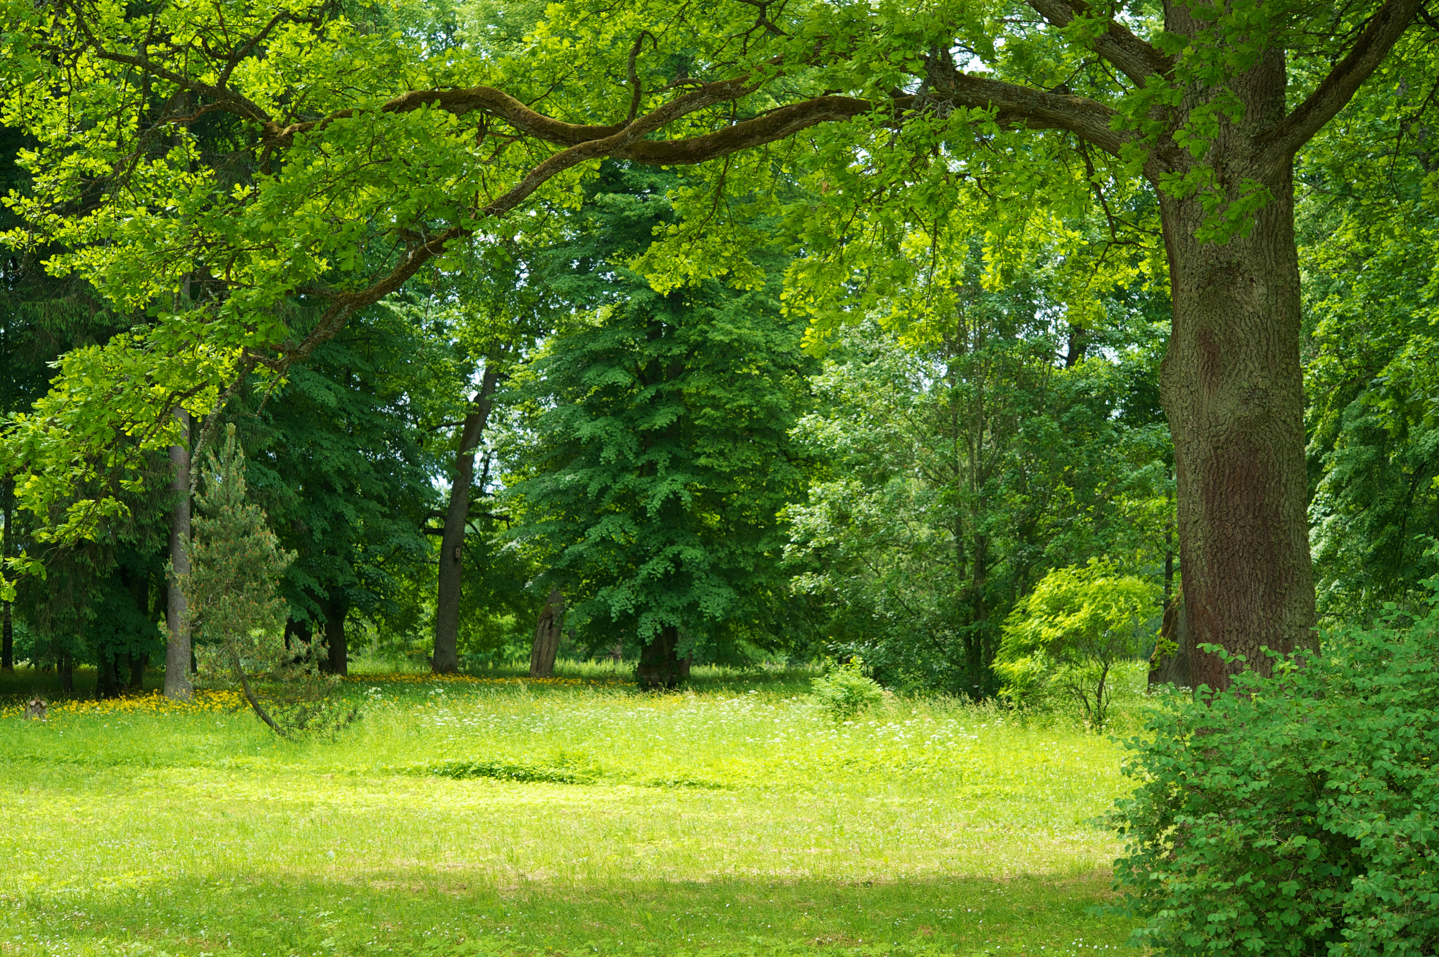

AND THE
VIDEO
Notes:
Aaro
-Put a question + text

Slide 20
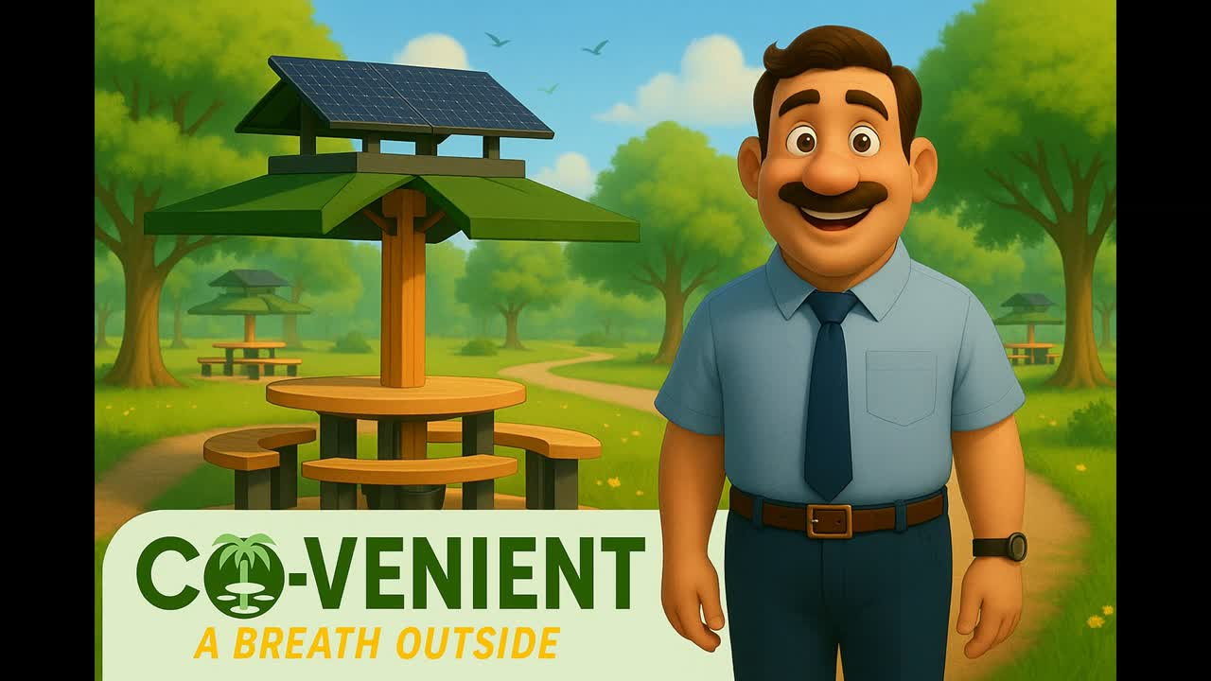
Notes:
Aaro
-Put a question + text

Slide 21

THE ESTIMATED COST
9 000 €
Notes:
Wiktoria

Slide 22
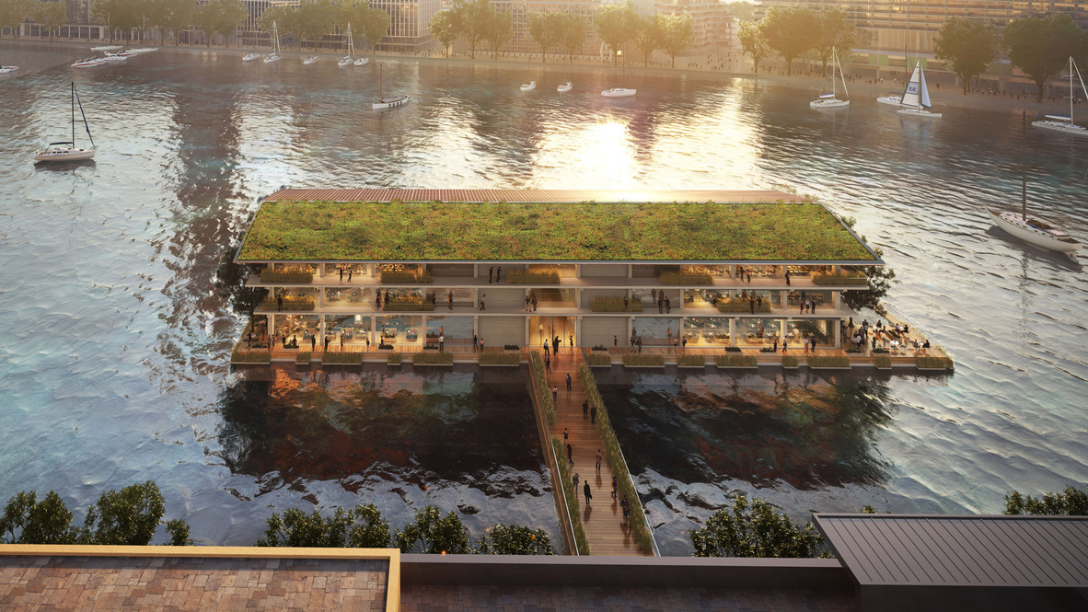

IDEAS
FOR THE
FUTURE
Notes:
Waad

Slide 23
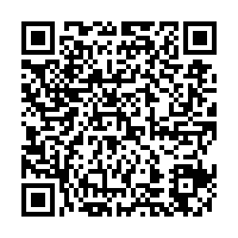
  FIND OUT EVERY DETAIL HERE
Notes:
Waad

